Slide 1
FaFi
Team 5 Iteration 3 Updates

Slide 2
Agenda
Team Introductions
Project Overview & Requirements
Project Requirements technical and functional
High level Components
Project Design
Software Architecture
Software Design
Project Configuration
Dependencies
Github Branching Strategy
Project Security
Encryption
Authentication
Project Testing/QA
PyTest and Github Actions

Slide 3
Team intro

Slide 4



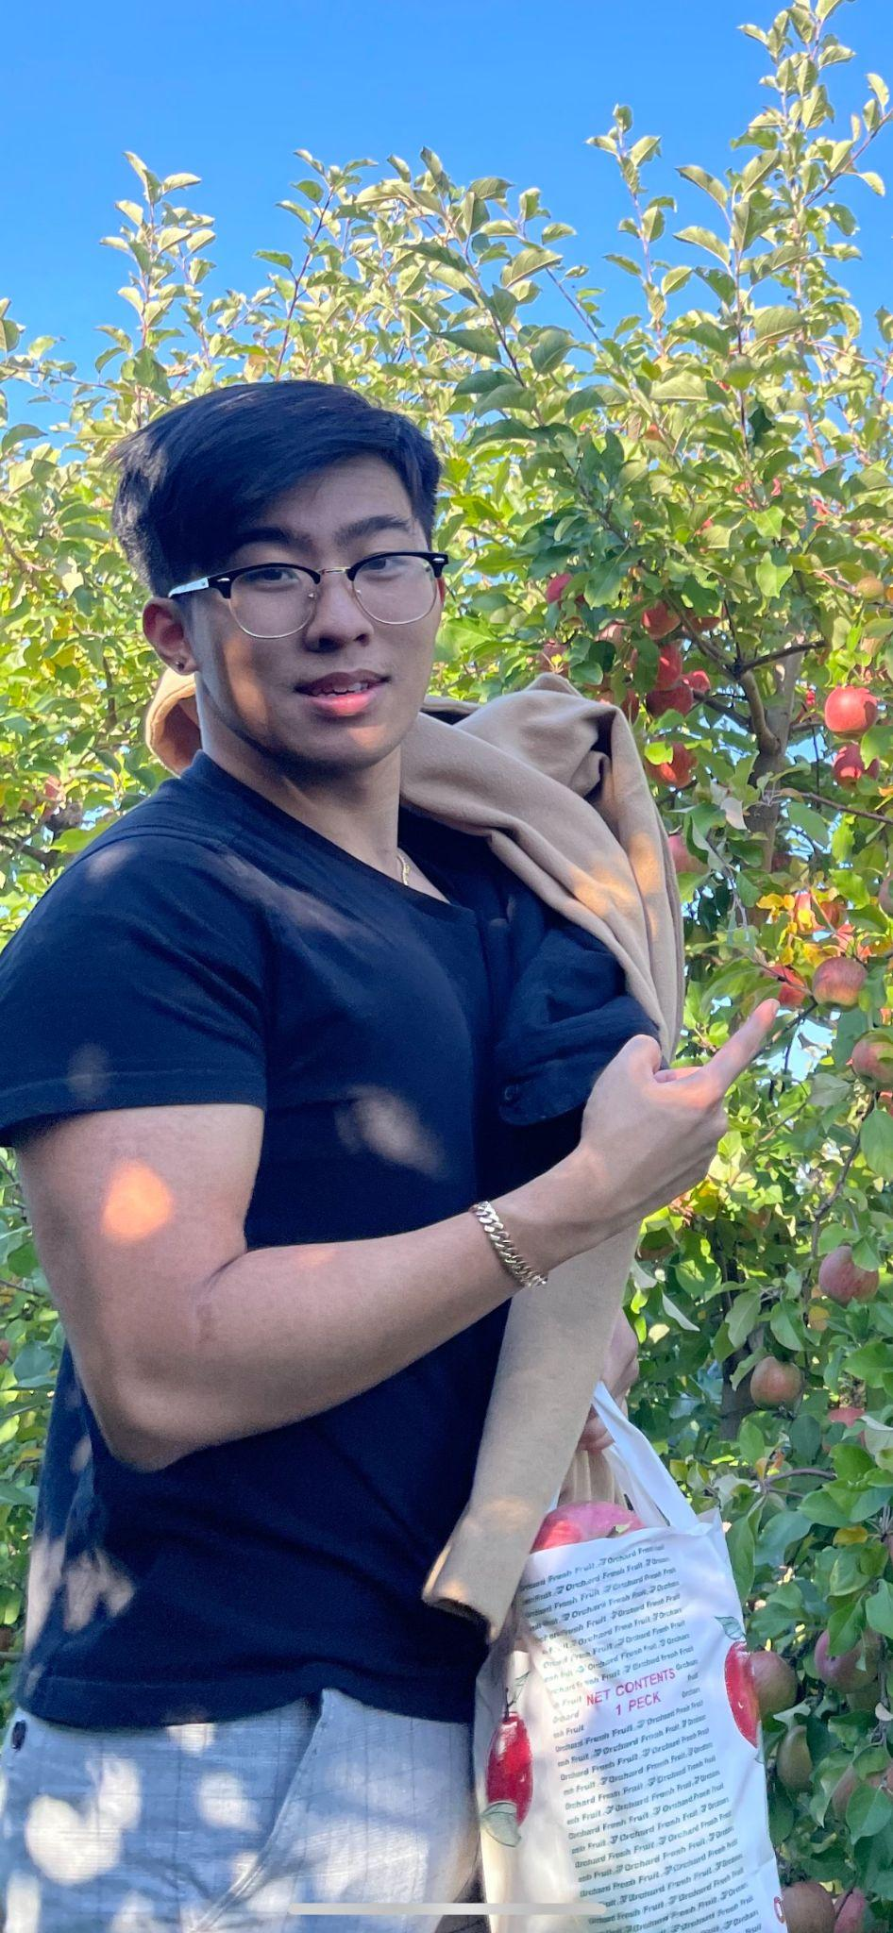

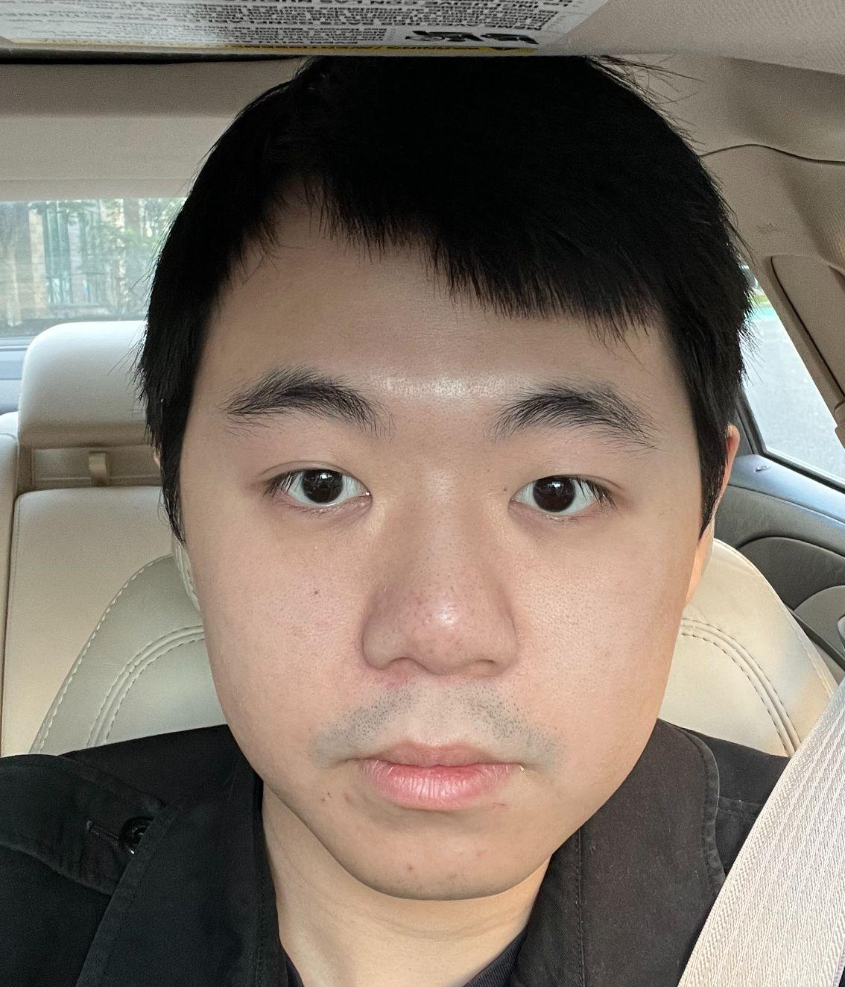
Team introduction
frame
Team Lead Matthew Kluska
Design and Implementation Lead Aidan Chang
Configuration Lead Derric Syme
QA Lead Brendan Troung
Requirements Lead Patounezambo
Ouedraogo
Security Lead Zengrui Lou

Slide 5
Project Overview

Slide 6
Goals/Requirements of our Application
frame
Technical
Functional
The technical goals of FaFi are the following:
The FaFi application implements a person detection algorithm using the latest in computer vision based machine learning.
A Surveillance mode can be turned on and stores a snapshot of the video along with other information whenever people are detected inside the video, then an email notification will be sent to the email on file.
.
The design goals of FaFi are the following:
Efficiency- The ML algorithm used in this application must be efficient.
Reliability- The people detection and email notification must be reliable.
Security- The security of the end user’s account and the privacy of the history must be secured.
Robustness- The application must be able to run in all environments, handle errors, be fault tolerant and pass thorough testing.

Slide 7




Tech Stack Overview
frame
Front end - Flask, Flask-Login, Flask-Mail
Back end server - SQlite3, Flask Framework
ML framework - Pytorch, OpenCV

Slide 8
State Diagram
Users DB
A video stream is started automatically upon login and the user is in the main page. Any people detected trigger a entry into the Detection DB
User Profiles are checked against the USer DB
Access to the app is granted if the user is valid
Once the detection DB is populated, entries will show up on the history tab.
Login Page
Main Page
(Video Stream)
Detection DB
History Tab
Upon log-in the User is taken to the main page
Notifications can be triggered to notify the User via email if a video stream detects a person.
Notifications Tab

Slide 9

Login Page and Security
We developed a fully functioning login page. This login page is a major security upgrade to prevent unauthenticated access to our application.
We also took steps to prevent unauthorized access by:
Encrypting user data
checking addresses
input validation
We plan to do this via implementing MFA in the future

Slide 10
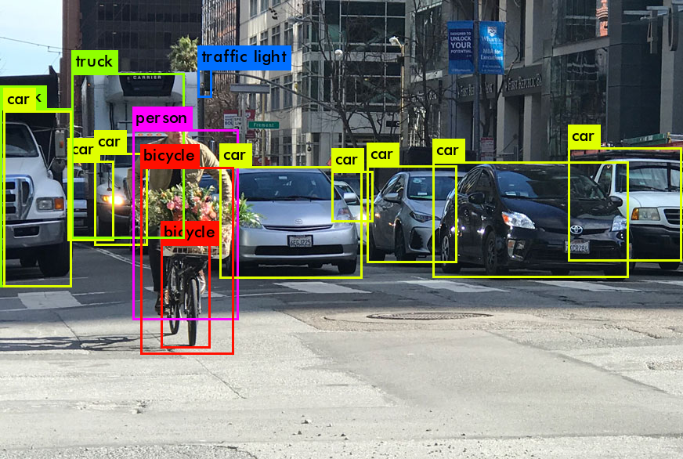
ML Algorithm
frame
We are using state of the art image detection
model called YoloV5
This is implemented in the ObjectDetection.py
file as a class. We read in a video stream
and have fine tuned the ML model
to detect people.

Slide 11
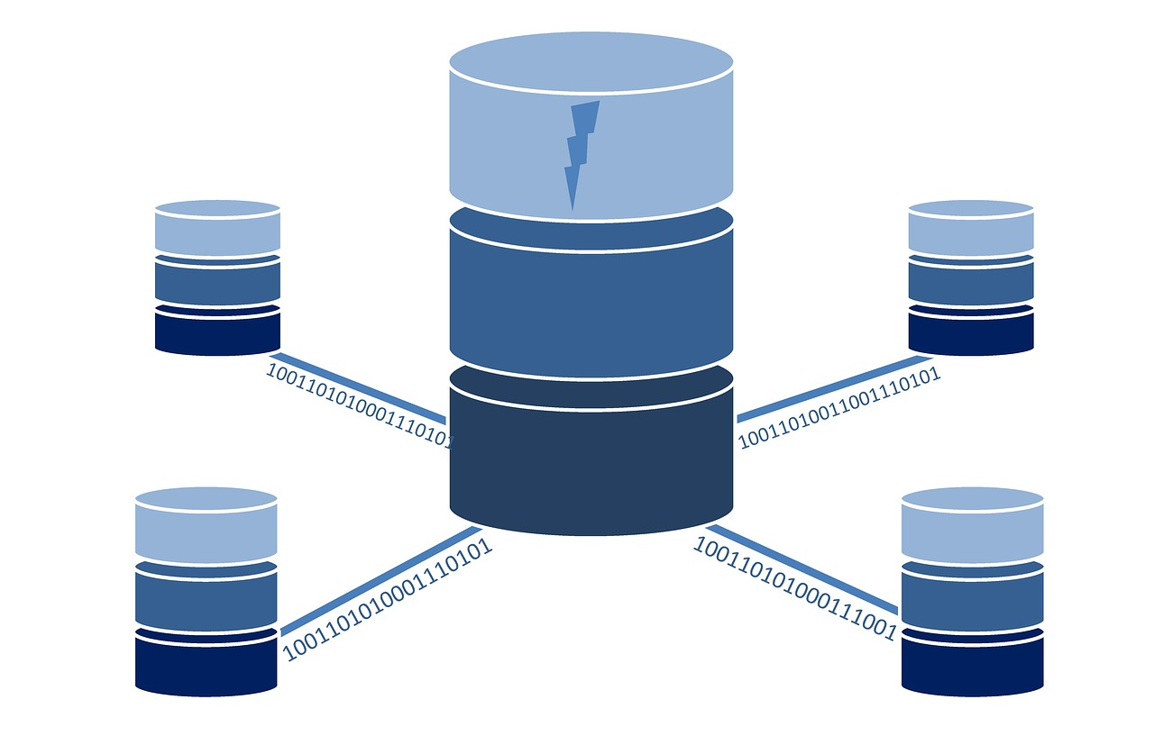
SQL DB Creation
In this Iteration we created 2 DataBases
1 to store user profiles
another to store the history of submissions
Standard SQL
Uses a python native library
SQLite3

Slide 12
Project Design

Slide 13
Class Diagram Recap
frame
Entities:
FaFI Web Application
Users
Images
Facial detection results
Controls:
Login
Signup
Upload File
Label prediction for model training
View History
ML Facial detection
Boundaries:
Login Page
Home Page
Stream Page
File Page
History Page
Setting Page

Slide 14
UI Design SDD
frame
Login page - Users can create and login to their account
Fields: User email and Password
Buttons: Sign Up and Sign In
Sign In redirects to Home Page
Sign Up redirects to Login interface. Accounts with passed username and password are created.
Home page
Navigation Bar:
Links to Stream, History, and Setting pages
Stream page
Functionalities:
Displays the live stream video with people detection feature

Slide 15
UI Design continued
frame
History page- Displays a history of events where people are detected.
Buttons: Click on an event to view the screenshot enlarged.
History Feature: Each event shows a screenshot with time it took place, and number of people detected.
Setting page- An end user can sign up for email notification to receive potential detection notifications from the application.
Fields: Email Address to receive notifications
Buttons:
Email Address: An end user can sign up for email notification which will sent a detection notification to the user's email address, and a screen shot of a video will be saved and stored in the History page.

Slide 16
Database Design
frame
The Database Design will consist of two tables. These tables will be created natively in python using the SQLite3 module.
The first table will house metadata about the uploaded image including attributes like person detected or not, unique identifying code, and timestamp. This table will then be used by the history tab, notification tab and future features.
The second table is used to save the user information. Including user email, username and password.
All the user information were encoded to base64 before writing into the database to prevent SQL injection.

Slide 17
Security Design
frame
We implemented an authentication mechanism to prevent unauthenticated use of our application by creating a username and password.
These values will be encrypted and stored within our database.
We’ll make use of the flask-login plugin to provide user session management.

Slide 18
Project Configurations
Notes:
Configuration of our project initialization, and I’ll discuss our git configuratiojn

Slide 19
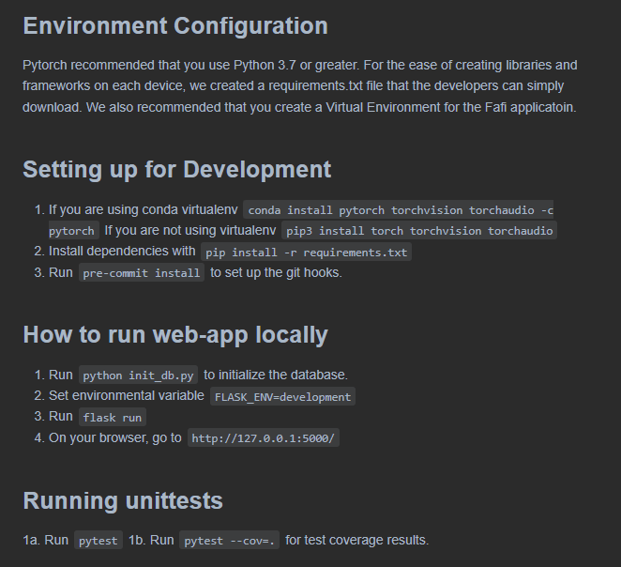
Runnable Code - README.md
Notes:
takeaways - Use some automation and establish ease of use by having a preference towards virtual environments, using requirements.txt, and utilizing git hooks,

Slide 20
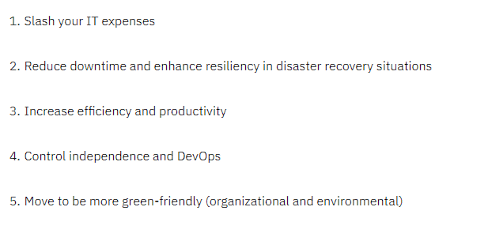
IBM’s 5 Benefits of Virtualization

Slide 21
Dependencies
We kept track of project dependencies thru a requirements.txt file. Those can be installed into a virtual environment via conda or pip
Databases need to be initialized by running python_init_db.py
Finally the Web Server is initialized by running the command flask run

Slide 22



Git Hooks - See TESTING
Git hooks are scripts that Git executes before or after events such as: commit, push, and receive.

Slide 23

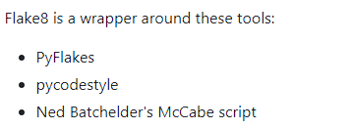
Git Hooks - See TESTING
Black is a PEP 8 compliant opinionated formatter. Black reformats entire files in place. Style configuration options are deliberately limited and rarely added. It doesn't take previous formatting into account.
Static source code analysis
Verifies pep8, pyflakes and circular complexity

Slide 24
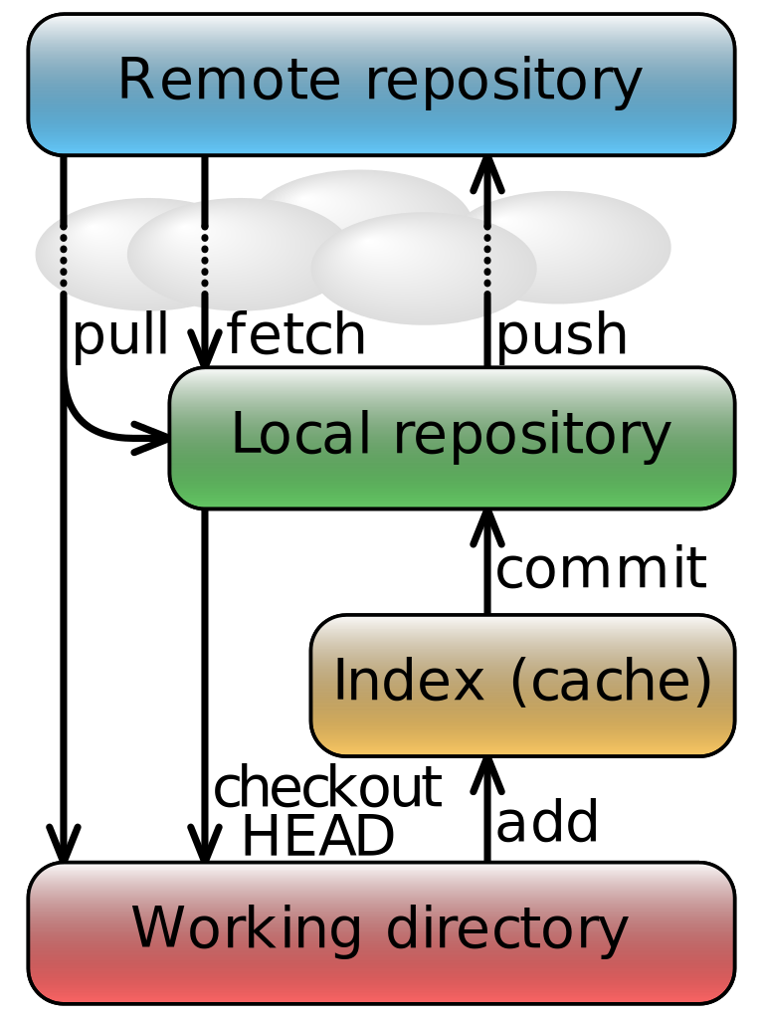



Github Branching strategy
We used a standard dev staging branching strategy.
First we would branch off of a development branch to create a feature, then we would make commits to this feature. After everything in Dev passes testing, these changes would be merged to the main branch approximately once a week.

Slide 25
Security

Slide 26
IAAA
Identification: The codebase is stored in a private repository on github.
Authentication: The flask server requires a username and password to access.
Authorization: Because the application is hosted locally, it is unreachable to unauthorized users
Accessibility/Accountability: Users with access to the repository can create an account and use our application

Slide 27
Security Design
frame
We plan to implement an authentication mechanism to prevent unauthenticated use of our application by creating a username and password.
These values will be encrypted and stored within our database.
We’ll make use of the flask-login plugin to provide user session management.

Slide 28
Sign Up page
A signup page allows for there to be role-based/individual access to the application. This allows auditors and accountability of the application.
Ethical artificial intelligence auditors can see if we are using the ML application responsibly or not
Security auditors can see if we uphold good security practices when using the application.

Slide 29
Login/Logout page
This functionality allows us to securely access the application when in use and to securely log off. This prevents hackers from accessing the application when a user is away from his/her keyboard.

Slide 30
Testing

Slide 31
Testing Responsibilities
Unit Tests will be written by each member for the functions that they code.
Integration, Regression, System, and Acceptance tests will be lead by the QA leader.

Slide 32
Test Types
Unit Tests
PyTest assert function outputs with expected results
Queries
Regression Tests
PyTest GET and POST requests to flask web application
Check if response STATUS CODE = 200 OK
Ensures code change does not break web application
System and Acceptance Testing
Assume the role of a user and interact with web app
Login
Visit different tabs
Trigger ML detection
View history

Slide 33
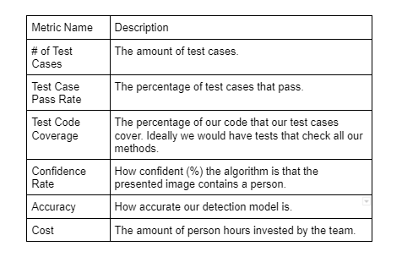
Testing Metrics

Slide 34
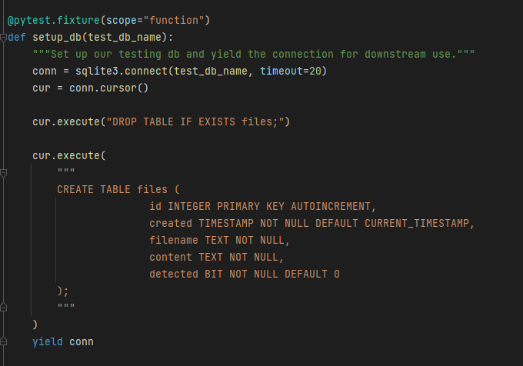
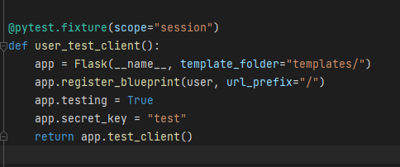
Pytest Conftest

Slide 35
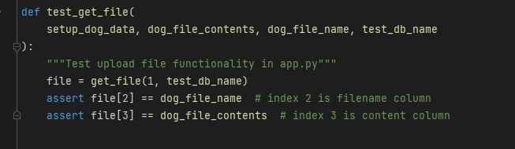
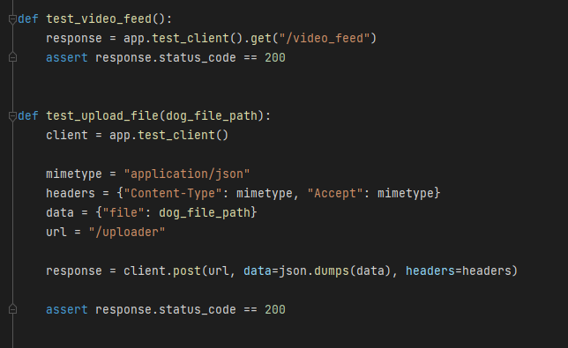
Pytest Examples

Slide 36
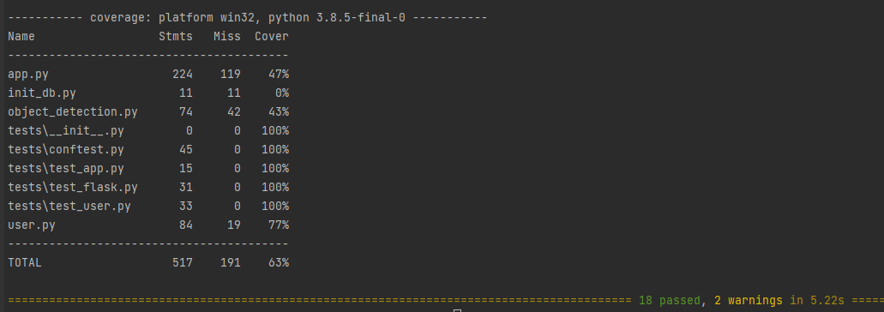
Pytest Example Results

Slide 37
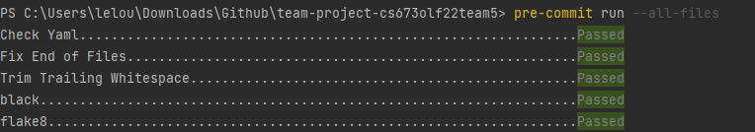
Automated Testing - Pre-Commit
Use pre-commit to set up Git hooks
Runs automatically every time we commit a code change
Flake8 checks for PEP8 Standards
Black parses and updates code styling

Slide 38
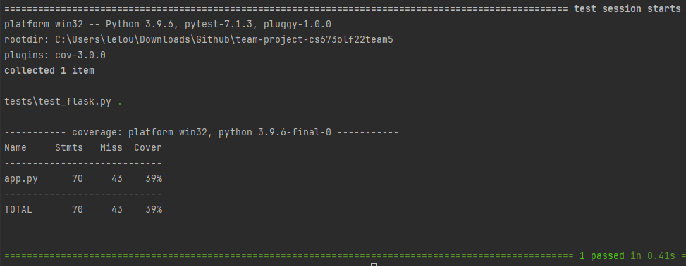
Automated Testing - Pytest
Main Testing Framework
Used to write Unit Tests and Regression Tests
asserting function output against expected result
assert request response against web application
Integrate PyTest-Cov plugin for code coverage

Slide 39
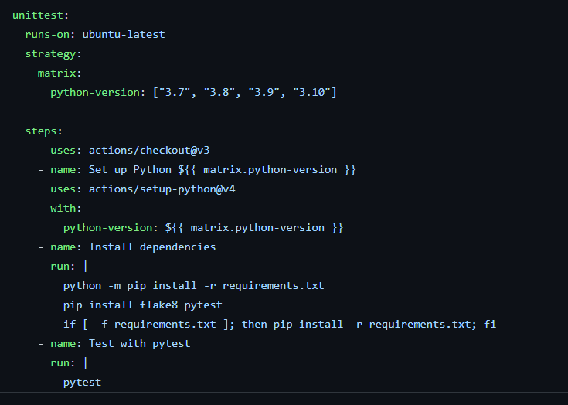
Automated Testing - Github Actions
Plans to use Github Actions
Trigger CI/CD workflow to lint and run tests on each PR
Runs workflow on a remote runner
Ensures tests must pass before a code change
Enables linting of code before a merge to main
Github Actions Config

